Slide 1

Surviving the Titanic
Mike Dean

Slide 2
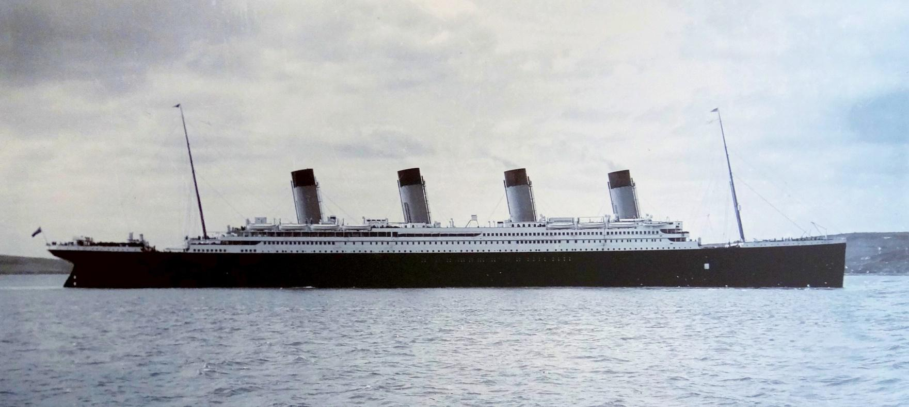
Overview
Background
Data
Methods
Results

Slide 3
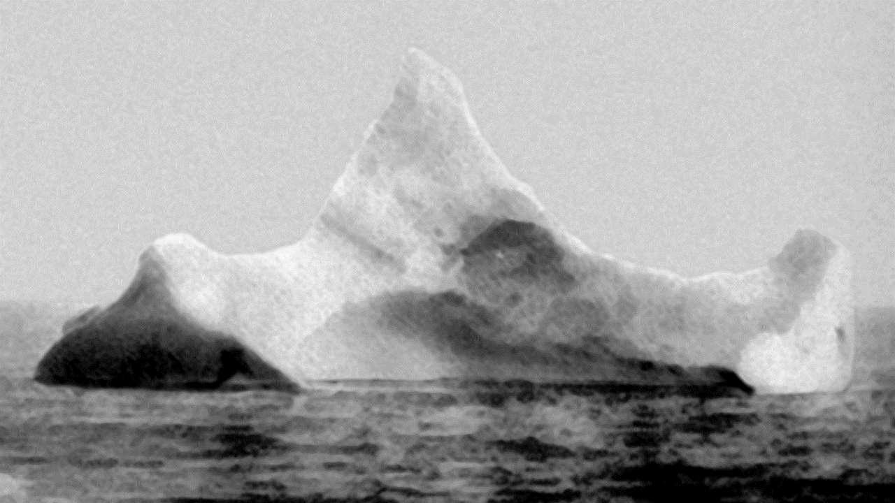
Background
Maiden Voyage from Southampton, UK to New York, NY on April 10, 1912.
1,317 passengers onboard.
Manned by a crew of 885.
Struck an iceberg on April 14, 1912 at 11:40 PM.
1,504 people died with a survival rate of approximately 31.70%
Notes:
The ship also stopped in the ports of Cherbourg, France and Queenstown, Ireland.

Slide 4
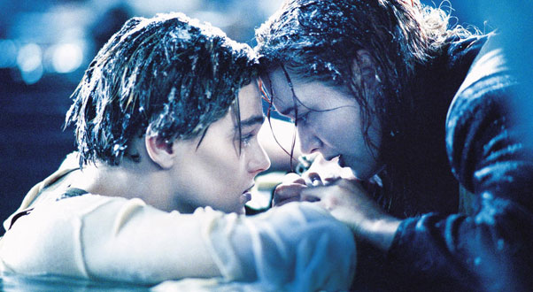
Evacuation
As was (and still is) common, the evacuation took a “Women and Children first” policy.
The ship took 2 hours and 40 minutes to sink.
Twenty two lifeboats were onboard which could hold a total of 1,178 people.
Notes:
The capacity of the ship was 3327, about 50% more than the 2202 on board.
The lifeboats held anywhere from 40 – 65 people each.
The Titanic had the capacity to hold 64 lifeboats, which would have been enough for 4,000 people. English standards at the time only required that they be able to evacuate 990 people.

Slide 5

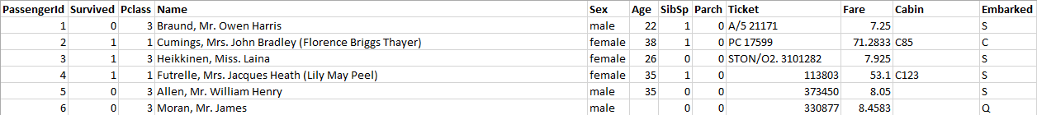
Data
Obtained from
Divided into a training set of 891 passengers and a test set of 418 passengers.
Contained identifying information for each passenger

Slide 6



Methods
Excel
Python – Random Forest
R – Decision Tree & Random Forest
Notes:
Excel was mostly used to look at the data initially and determine some easily visible patterns.
Python was used to generate the same data as the initial excel analysis and use a random forest analysis

Slide 7
Results

Slide 8
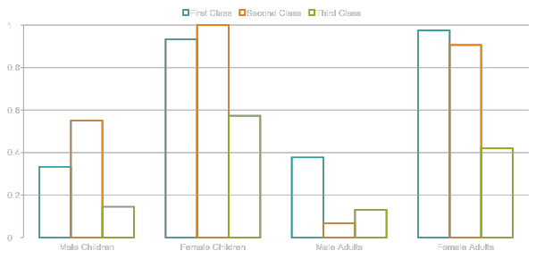
Survival Rates by Age, Sex, and Class (Child < 18 Years Old)
Notes:
Max: 2nd Class Female Children - 100% Survival Rate, Min: 2nd Class male adults – 6.82% survival rate.

Slide 9
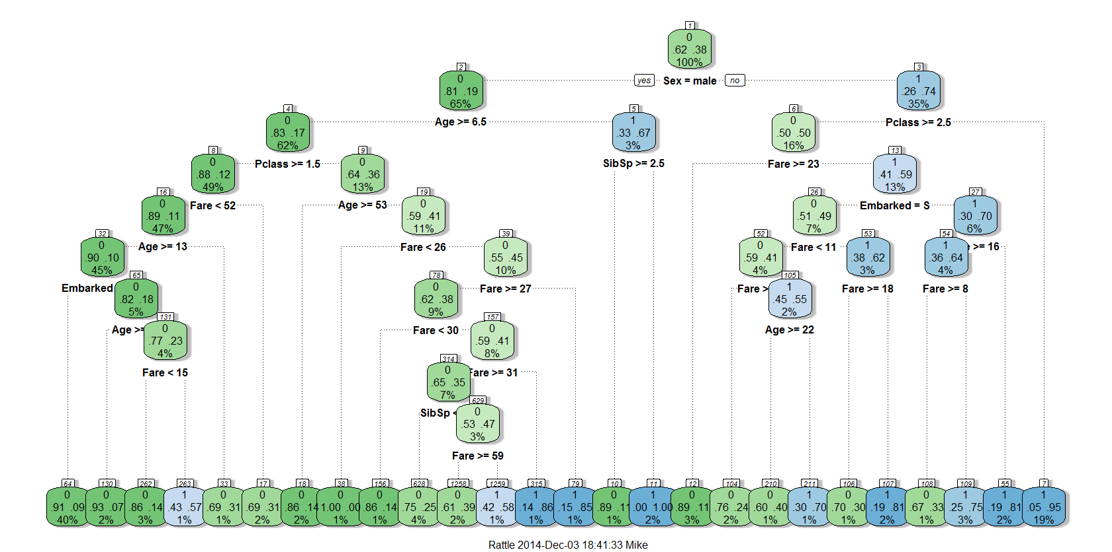
Decision Trees
A decision tree is a simple classification method.
Data point starts at the top (root) node and works through the tree until classified.

Slide 10
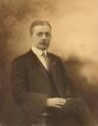

PassengerId | Survived | Pclass | Name | Sex | Age | SibSp | Parch | Fare | Embarked | Child
7 | 0 | 1 | McCarthy, Mr. Timothy J | male | 54 | 0 | 0 | 51.86 | S | 0
23 | 1 | 3 | McGowan, Miss. Anna "Annie" | female | 15 | 0 | 0 | 8.02 | Q | 1

Slide 11
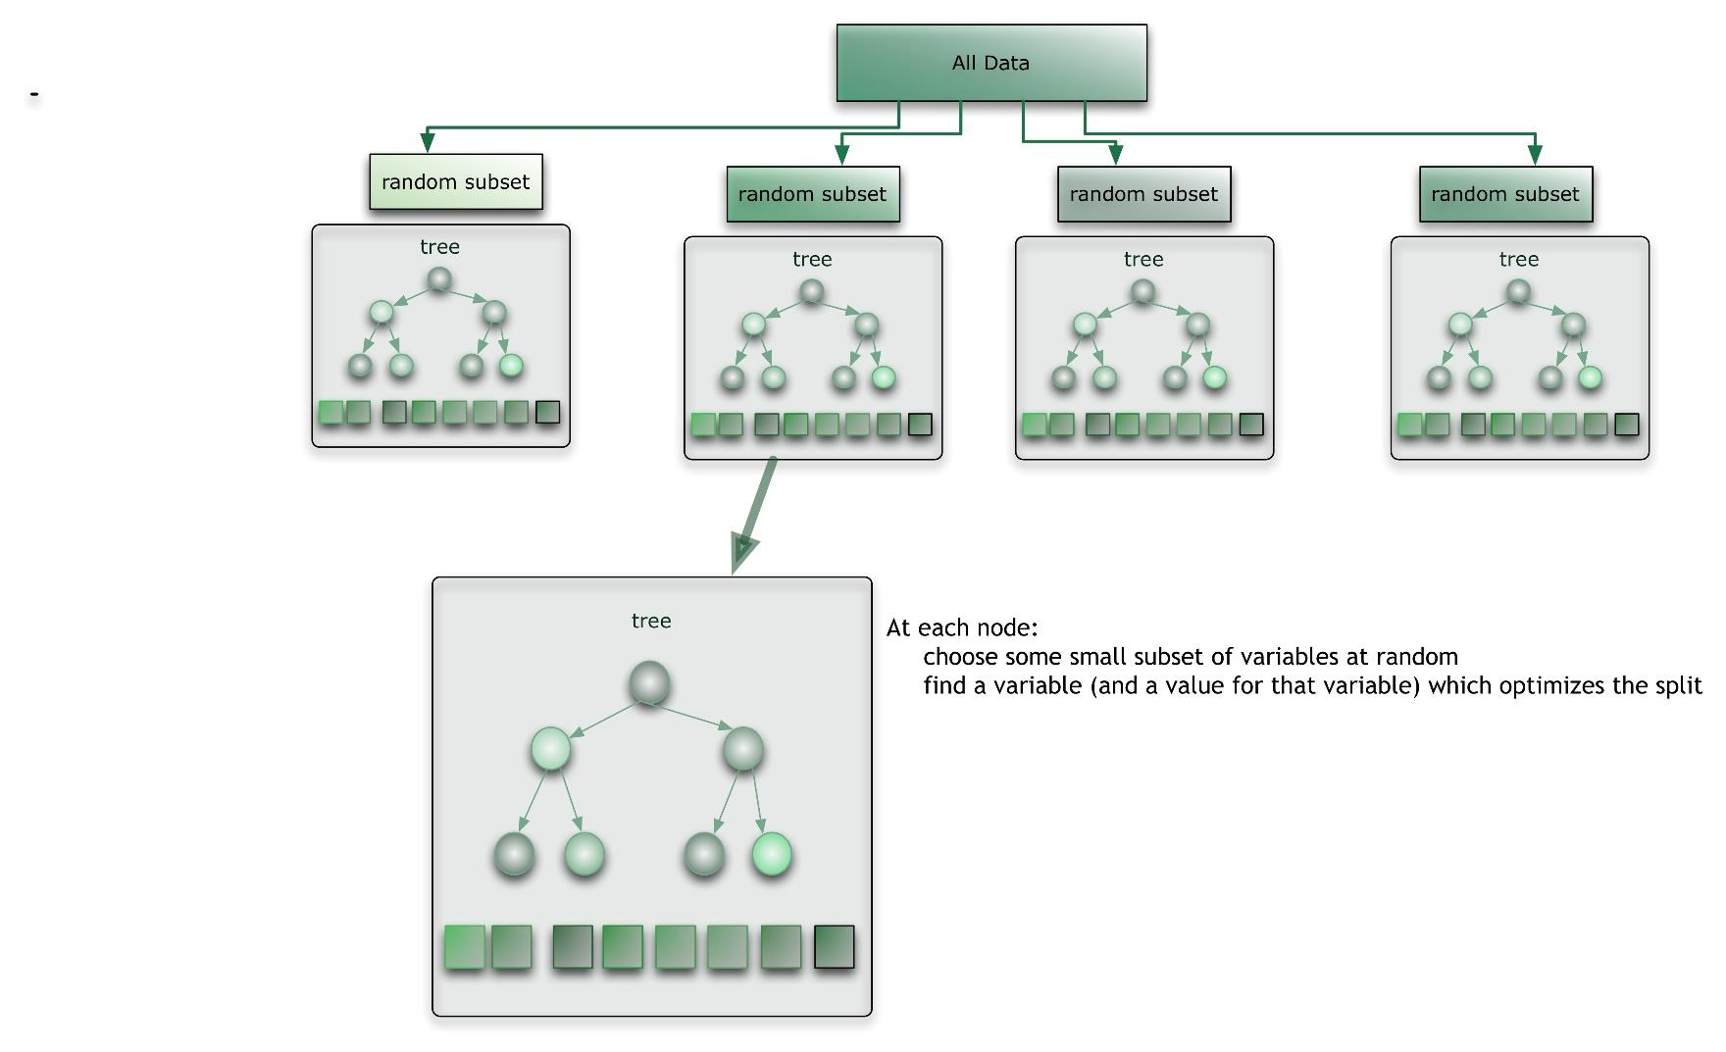
Random Forest
A “forest” of decision trees in which each tree gets a “vote”

Slide 12

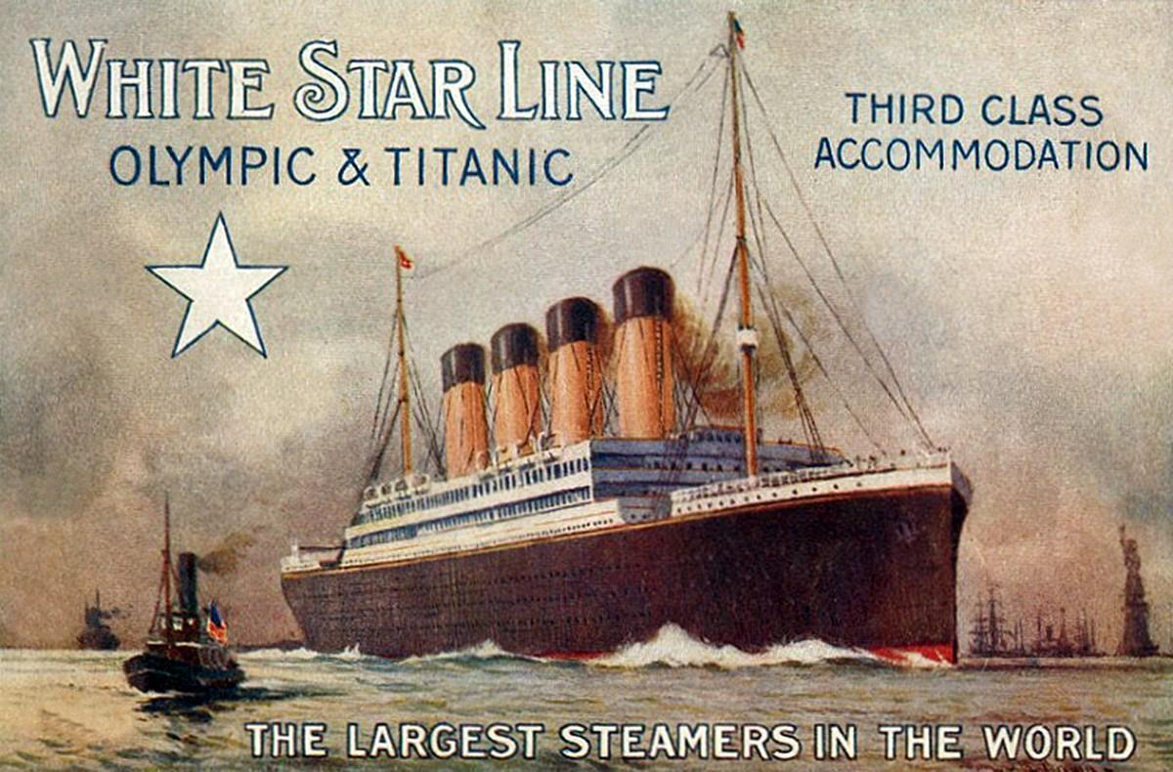
Variable Importance
Title
Fare
Pclass
FamilyID2
Sex
Age
FamilySize
Embarked
SibSp
Parch

Slide 13
